Slide 1
Personal Fitness & Workout Tracker
A Java-Based Fitness Management Application
Presented By
Project Details
S. Meghana — Roll No. 2620030645
K. Raghavendra Varma — Roll No. 2620030549
P. Pranathi — Roll No. 2620030670
Department: CSE
Faculty Guide: G.Mamatha

Slide 2
Abstract
Problem & Objective
Tracking workouts by hand is slow and easy to get wrong. This makes it hard to track progress and keep records.
This project is a Java-based Personal Fitness & Workout Tracker. It records each workout's exercise name, duration, and calories burned.
The program uses Java concepts to calculate total duration and total calories. Users can search by exercise name and sort by duration.
Workout data is saved to and loaded from workouts.txt, so progress is kept between sessions. The app creates a fitness summary using the Streams API. A menu with input checks helps prevent wrong entries.
Technology Stack
Java 8+, Collections Framework (ArrayList), Streams API, File I/O (BufferedReader / PrintWriter), and Object-Oriented Design

Slide 3

CO1 / Module 1: Java Foundations
FROM PROBLEM TO PROGRAM
Key Concepts
Program: Basic Workout Summary
Variables, constants, primitive data types
Identifiers, literals, arithmetic & assignment operators
Type conversion and expression evaluation
Scanner for input, formatted output with System.out.println() and printf()
Sequential execution flow
Scanner sc = new Scanner(System.in);
System.out.print("Enter your name: ");
String name = sc.nextLine();
System.out.print("Enter exercise name: ");
String exercise = sc.nextLine();
System.out.print("Enter duration (min): ");
int duration = sc.nextInt();
System.out.print("Enter calories burned: ");
int calories = sc.nextInt();
System.out.println("\nWorkout Summary");
System.out.println("User: " + name);
System.out.println("Exercise: " + exercise);
System.out.println("Duration: " + duration
+ " minutes");
System.out.println("Calories burned: "
+ calories + " kcal");
Sample Output
PERSONAL FITNESS TRACKER — CO1
Enter your name: Rahul
Enter exercise name: Running
Enter duration in minutes: 30
Enter calories burned: 250
Workout Summary
User: Rahul
Exercise: Running
Duration: 30 minutes
Calories burned: 250 kcal

Slide 4
CO2 / Module 2: Control Flow
SELECTION AND ITERATION
Key Concepts
Program: Workout Menu with Selection
if, if-else, nested if, if-else-if
switch, break, default
for, while, do-while loops
Menu repetition and input validation
while (!exit) {
System.out.println(
"1. Running 2. Cycling"
+ " 3. Walking 4. Exit");
System.out.print("Choose: ");
choice = sc.nextInt();
switch (choice) {
case 1: case 2: case 3:
System.out.print("Duration (min): ");
int duration = sc.nextInt();
if (duration > 0) {
System.out.println(
"Workout duration: "
+ duration + " min");
} else {
System.out.println("Invalid input");
}
break;
case 4:
System.out.println("Goodbye!");
exit = true; break;
default:
System.out.println("Invalid choice");
}
}
Sample Output
PERSONAL FITNESS TRACKER — CO2
1. Running 2. Cycling
3. Walking 4. Exit
Choose an option: 1
Enter duration in minutes: 30
Running selected.
Workout duration: 30 minutes
Choose an option: 4
Exiting Fitness Tracker. Goodbye!

Slide 5

CO3 / Module 3: Methods, Recursion & Arrays
DECOMPOSITION WITH METHODS AND ARRAYS
Program: Workout Duration Analysis
Key Concepts
int[] durations = {30, 45, 20};
System.out.print("Workout Durations: ");
for (int d : durations)
System.out.print(d + " ");
int total = 0;
for (int d : durations) total += d;
System.out.println(
"\nTotal: " + total + " min");
System.out.printf(
"Average: %.2f min\n",
(double) total / durations.length);
System.out.print("Search duration: ");
int search = sc.nextInt();
boolean found = false;
for (int d : durations) {
if (d == search) {
found = true; break;
}
}
System.out.println(
found ? "Found" : "Not found");
User-defined methods, parameters, return values
Method invocation and method overloading
One-dimensional arrays and array traversal
Summation, average calculation, linear search
Enhanced for loop
Sample Output
PERSONAL FITNESS TRACKER — CO3
Workout Durations: 30 45 20
Total Workout Duration: 95 minutes
Average Duration: 31.67 minutes
Enter duration to search: 45
Duration 45 minutes found.
Methods promote code reuse — each calculation is encapsulated in its own method for clean, modular design.

Slide 6
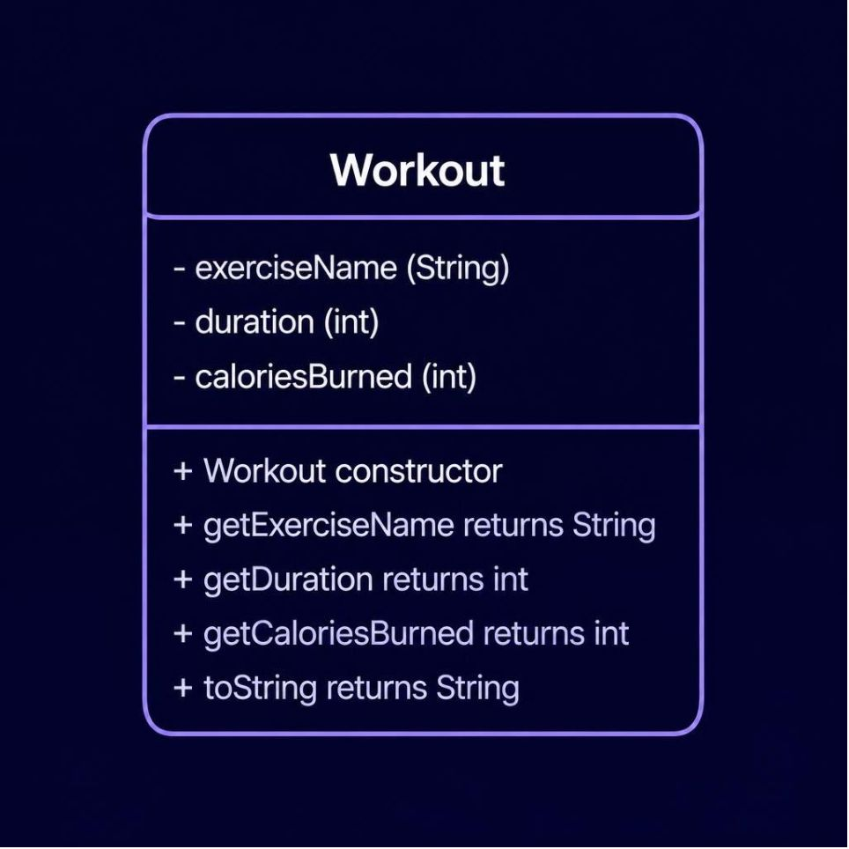
CO4 / Module 4: Object-Oriented Programming & Exception Handling
OBJECT-ORIENTED MODELLING AND DESIGN
Workout Class Definition
class Workout {
private String exerciseName;
private int duration, caloriesBurned;
public Workout(String name,
int dur, int cal) {
this.exerciseName = name;
this.duration = dur;
this.caloriesBurned = cal;
}
public String getExerciseName() {
return exerciseName;
}
public int getDuration() {
return duration;
}
public int getCaloriesBurned() {
return caloriesBurned;
}
@Override
public String toString() {
return "Exercise: " + exerciseName
+ "\nDuration: " + duration + " min"
+ "\nCalories: " + caloriesBurned
+ " kcal";
}
}
// Usage
Workout w = new Workout("Cycling",40,320);
System.out.println(w.toString());
Class Diagram
Sample Output
PERSONAL FITNESS TRACKER — CO4
Workout Details
Exercise: Cycling
Duration: 40 minutes
Calories Burned: 320 kcal

Slide 7
CO5 / Module 5: Strings, Library Algorithms & File I/O
WORKOUT HISTORY AND PERSISTENT STORAGE
Key Concepts
Program: File-Based Workout History
String methods: trim(), equalsIgnoreCase(), split()
Text parsing and validation
Arrays.sort() for ordering data
PrintWriter / BufferedReader for file I/O
Try-with-resources and exception handling
// Save workouts
try (PrintWriter writer = new PrintWriter(
new FileWriter("workouts.txt"))) {
writer.println("Running,30,250");
writer.println("Cycling,40,320");
writer.println("Walking,20,100");
}
System.out.println("Saved successfully");
// Load and display
try (BufferedReader reader =
new BufferedReader(
new FileReader("workouts.txt"))) {
String line;
while ((line = reader.readLine())
!= null) {
String[] parts = line.split(",");
System.out.println(
parts[0] + " — "
+ parts[1] + " min — "
+ parts[2] + " kcal");
}
}
System.out.println(
"Retrieved successfully");
Sample Output
PERSONAL FITNESS TRACKER — CO5
Workout records saved successfully.
Saved Workout History
Running — 30 minutes — 250 kcal
Cycling — 40 minutes — 320 kcal
Walking — 20 minutes — 100 kcal
Records retrieved successfully.

Slide 8

CO6 / Module 6: Collections, Functional Programming & Streams
SMART WORKOUT ANALYTICS
Key Concepts
Program: Stream-Based Workout Analytics
ArrayList, HashMap, HashSet and generics
Lambda expressions and functional interfaces
Predicate, Function, Consumer, Comparator
Stream operations: filter, map, sorted, count, collect
List<Workout> workouts = new ArrayList<>();
workouts.add(new Workout("Running",30,250));
workouts.add(new Workout("Cycling",40,320));
workouts.add(new Workout("Walking",20,100));
// Filter workouts >= 30 minutes
List<Workout> filtered = workouts.stream()
.filter(w -> w.getDuration() >= 30)
.collect(Collectors.toList());
System.out.println("Workouts >= 30 min:");
filtered.forEach(System.out::println);
// Calculate totals
int totalCal = filtered.stream()
.mapToInt(Workout::getCaloriesBurned)
.sum();
System.out.println(
"Count: " + filtered.size());
System.out.println(
"Total Calories: " + totalCal
+ " kcal");
Stream Pipeline
List Input
Count:2 Sum:570 kcal
Filter ≥30
Sample Output
Workouts lasting at least 30 minutes:
Running — 30 min — 250 kcal
Cycling — 40 min — 320 kcal
Qualifying Workouts: 2
Total Calories: 570 kcal

Slide 9
Final Integrated Project: Complete Personal Fitness & Workout Tracker
import java.io.*;
import java.util.*;
// CO4: class with private fields, constructor, getters
class Workout {
private String name;
private int duration;
private int calories;
public Workout(String name, int duration, int calories) {
this.name = name; this.duration = duration; this.calories = calories;
}
public String getName() { return name; }
public int getDuration() { return duration; }
public int getCalories() { return calories; }
}
public class PersonalFitnessTracker {
// CO6: ArrayList of objects
static ArrayList workouts = new ArrayList<>();
// CO1: Scanner for input
static Scanner scanner = new Scanner(System.in);
// CO2: menu loop with switch
public static void main(String[] args) {
int choice;
do {
System.out.println("1. Add 2. View 3. Total duration 4. Save 0. Exit");
choice = scanner.nextInt();
scanner.nextLine();
switch (choice) {
case 1: addWorkout(); break;
case 2: viewAll(); break;
case 3: System.out.println("Total: " + totalDuration() + " min"); break;
case 4: saveWorkouts(); break;
case 0: System.out.println("Goodbye!"); break;
default: System.out.println("Invalid choice.");
}
} while (choice != 0);
}
// CO3: small static methods
static void addWorkout() {
System.out.print("Exercise: ");
String name = scanner.nextLine();
System.out.print("Minutes: ");
int duration = scanner.nextInt();
System.out.print("Calories: ");
int calories = scanner.nextInt();
scanner.nextLine();
workouts.add(new Workout(name, duration, calories));
}
static void viewAll() {
for (Workout w : workouts)
System.out.println(w.getName() + " - " + w.getDuration() + " min - " + w.getCalories() + " kcal");
}
// CO6: one stream for totals
static int totalDuration() {
return workouts.stream().mapToInt(Workout::getDuration).sum();
}
// CO5: PrintWriter for saving
static void saveWorkouts() {
try (PrintWriter writer = new PrintWriter("workouts.txt")) {
for (Workout w : workouts)
writer.println(w.getName() + "," + w.getDuration() + "," + w.getCalories());
System.out.println("Saved to workouts.txt");
} catch (IOException e) {
System.out.println("Error: " + e.getMessage());
}
}
}

Slide 10
Integrated Output, Conclusion
Program Output
1. Add 2. View 3. Total duration 4. Save 0. Exit
Choose: 2
Running - 30 min - 250 kcal
Cycling - 40 min - 320 kcal
Choose: 3
Total: 70 min
Choose: 4
Saved to workouts.txt
Choose: 0
Goodbye!

Slide 11
THANK YOU

